Slide 1
Travelust Share your journal with people all around the world

Slide 2
Hello!
Our team member:
Long Vu
Phuc Ho
Joonas Lassila

Slide 3
Reflect The Project

Slide 4
Let’s Take A Look…
CONCEPT
Travelust is a web application developed for tourists, travel lovers, photographers… to share their beautiful moments of their trips.

Slide 5
Work Division
Joonas Lassila: Back-end
Long Vu: Back-end + Front-end
Phuc Ho: Front-end

Slide 6
Design Implementation

Slide 7
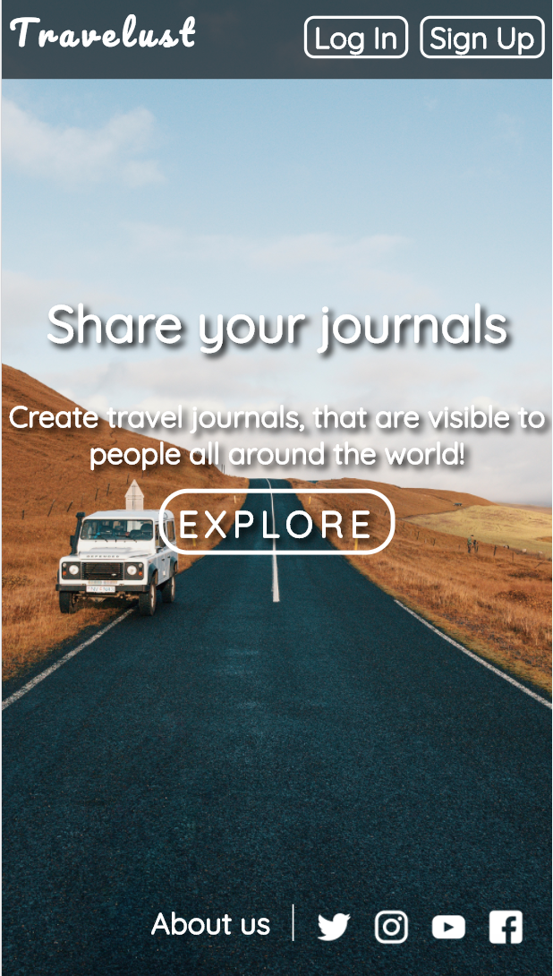
On Mobile Screen
Place your screenshot here

Slide 8
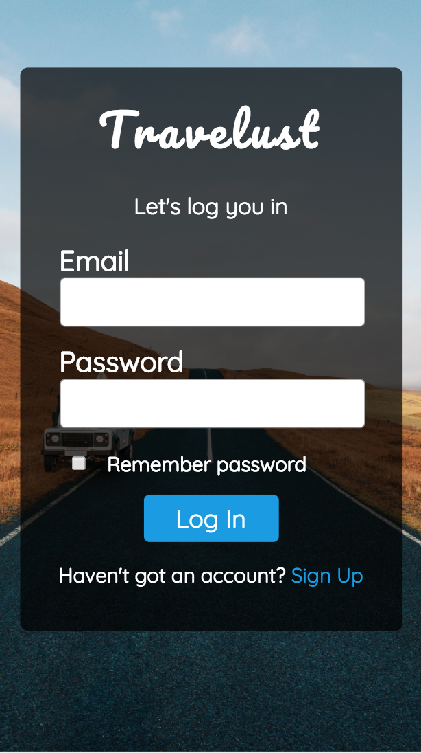
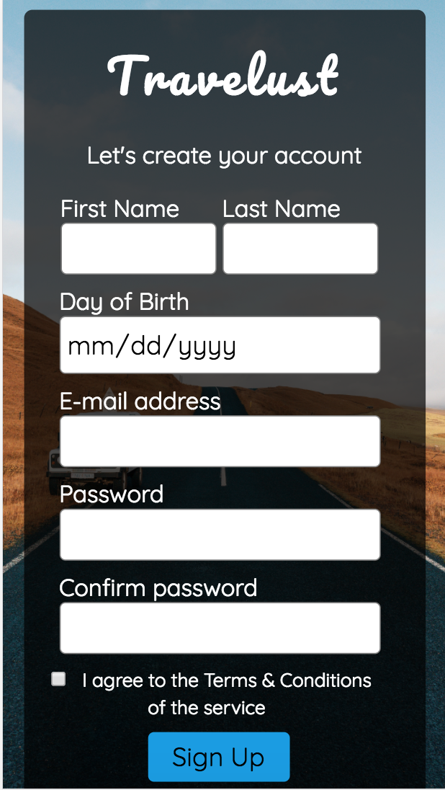
On Mobile Screen
Place your screenshot here
Place your screenshot here

Slide 9
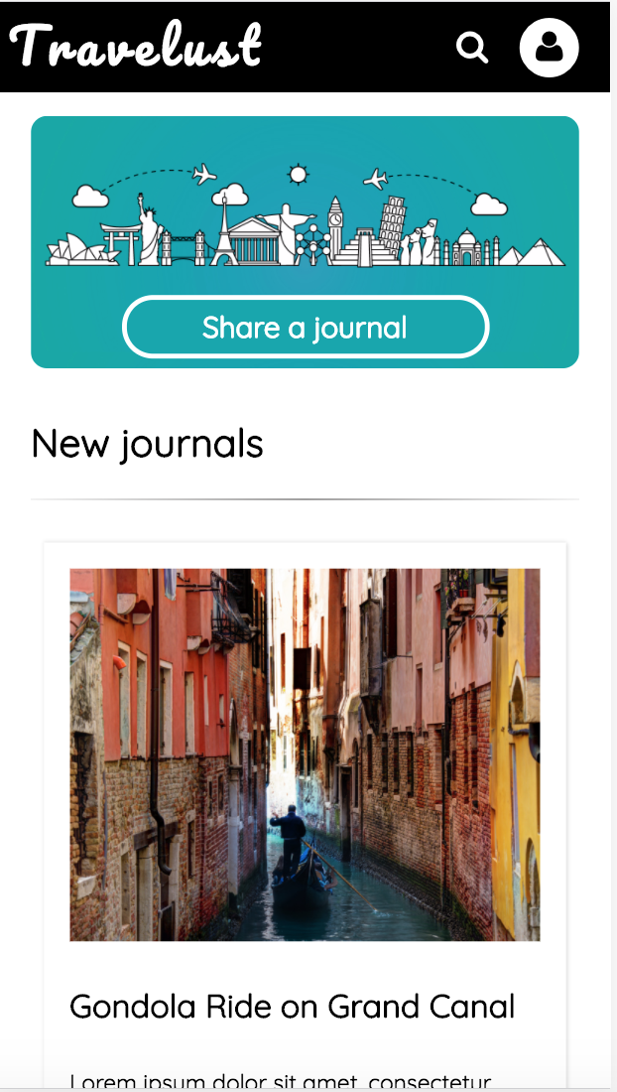
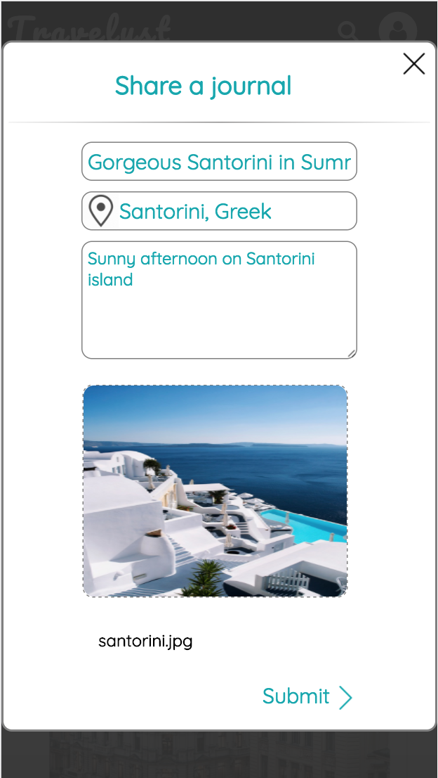
On Mobile Screen
Place your screenshot here
Place your screenshot here

Slide 10
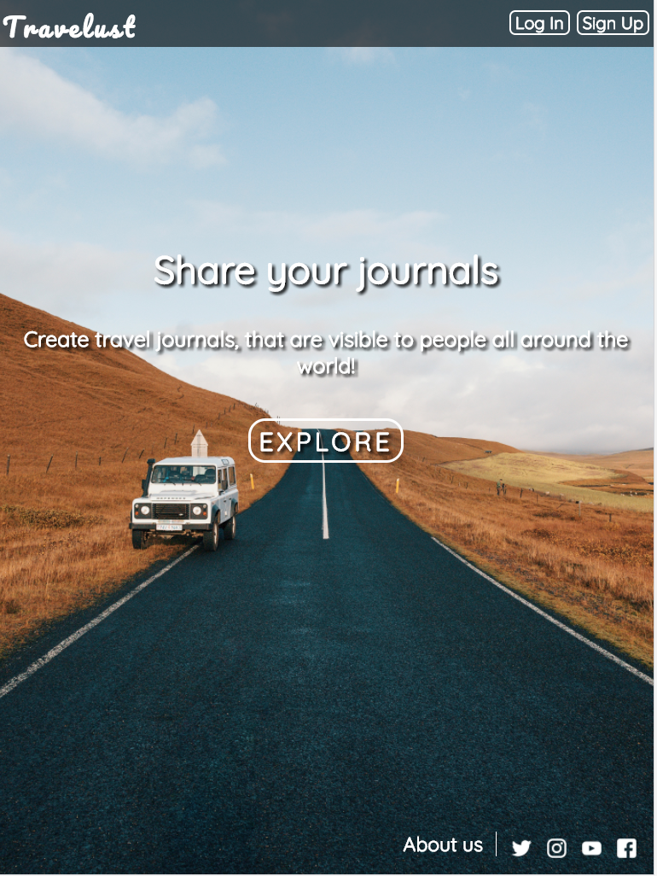
On Tablet Screen
Place your screenshot here

Slide 11
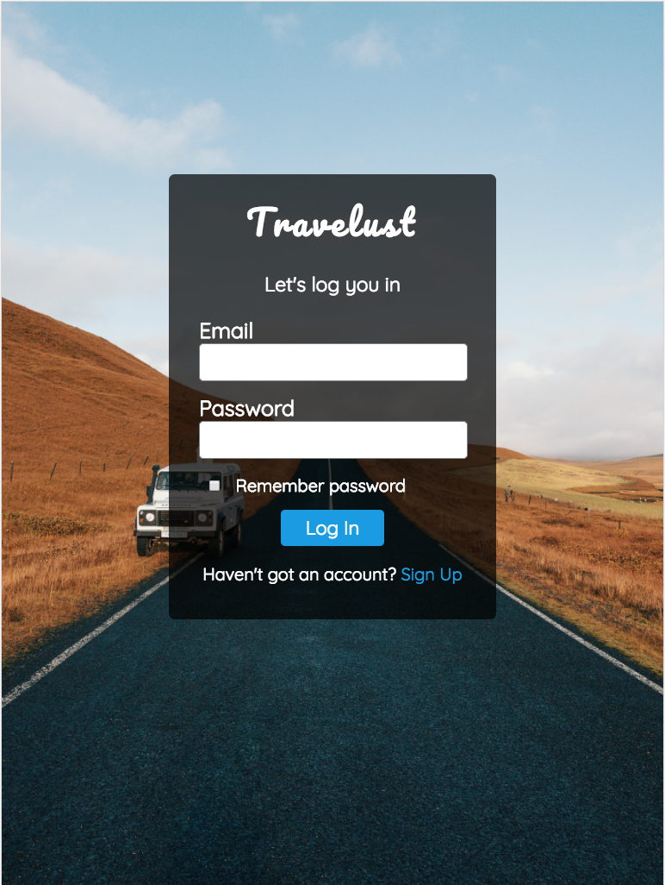
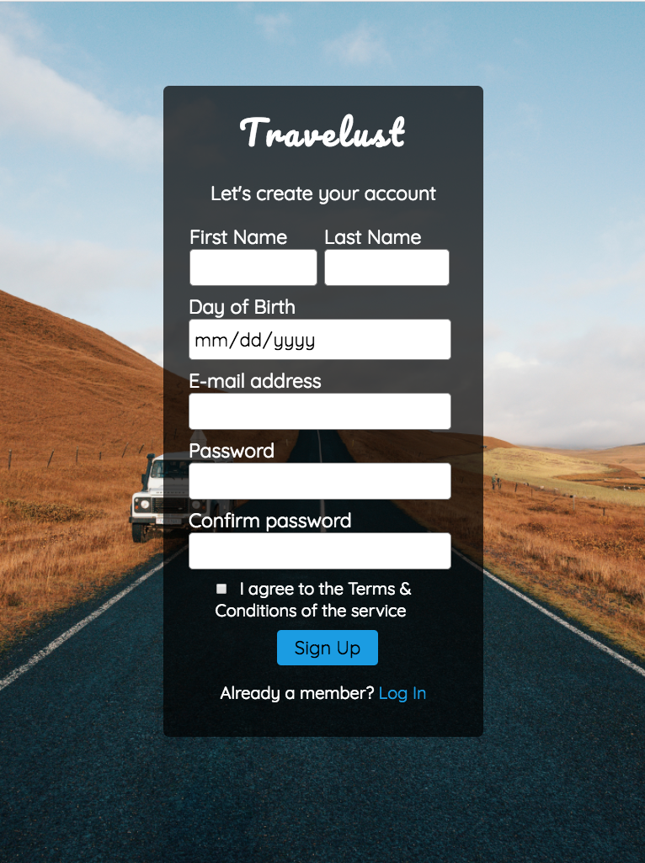
On Tablet Screen

Slide 12
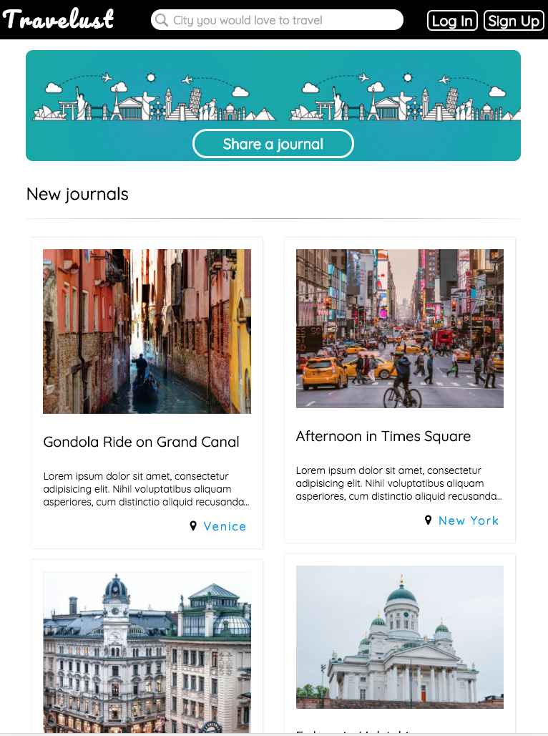
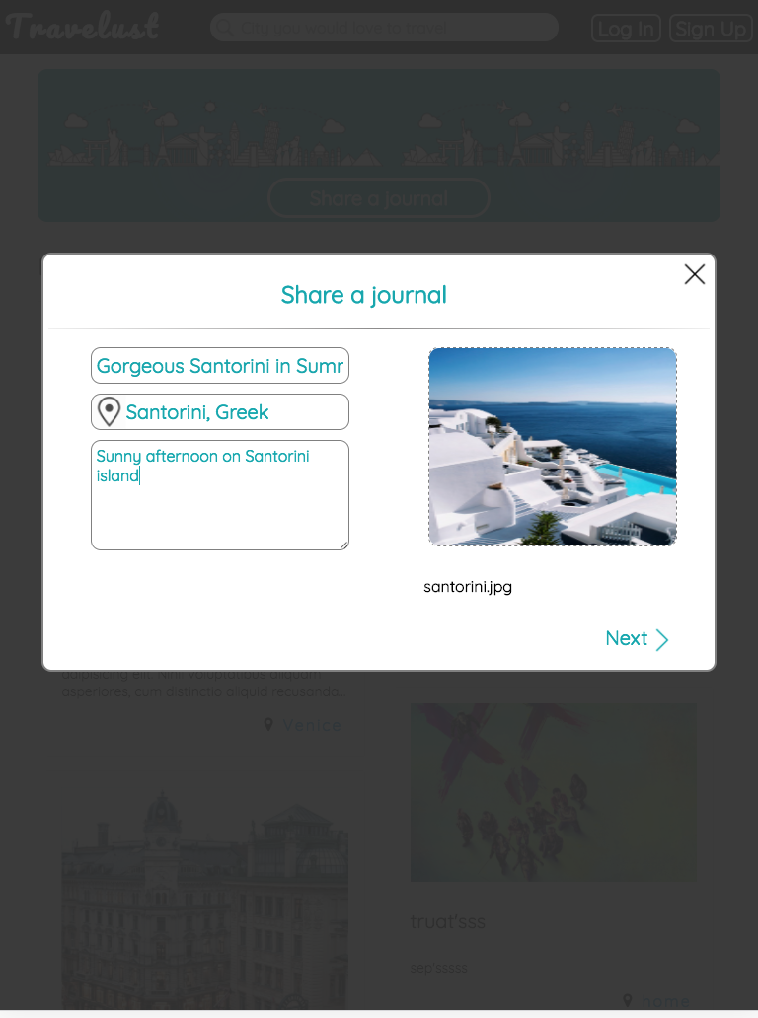
On Tablet Screen

Slide 13
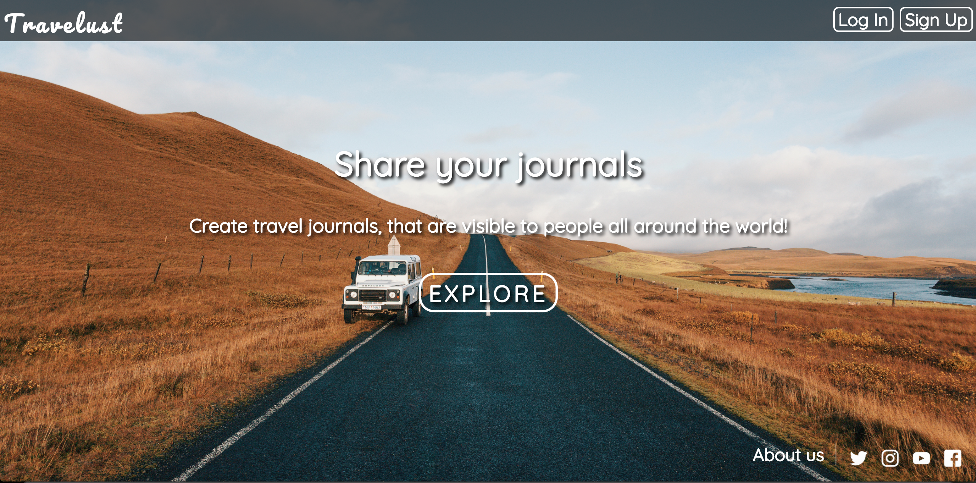
On DeSKTOP

Slide 14
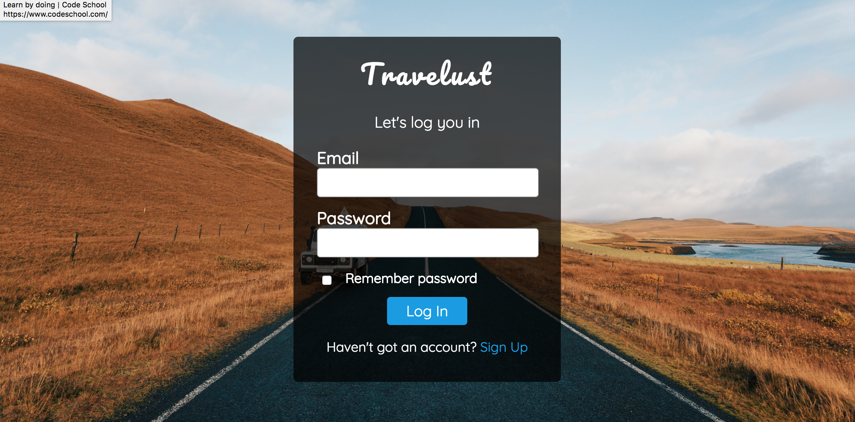
On DeSKTOP

Slide 15
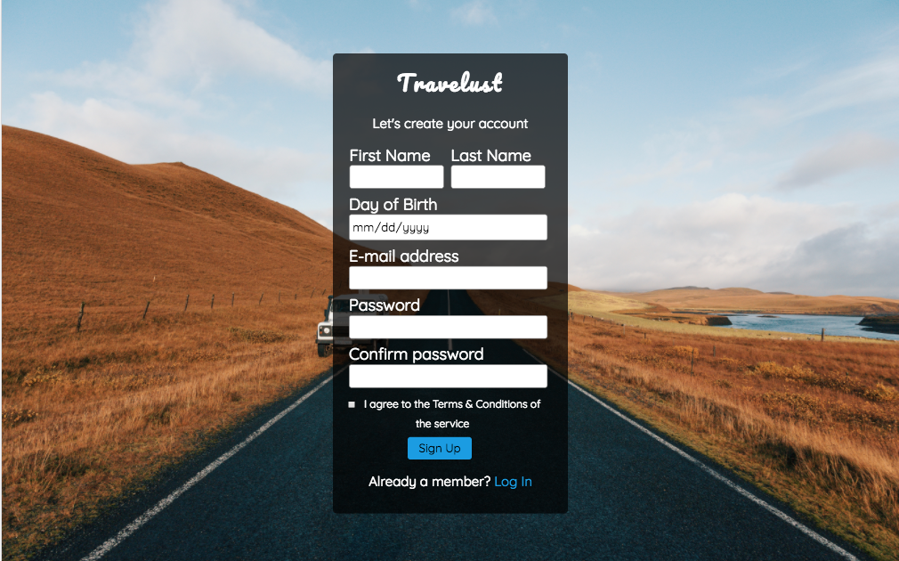
On DeSKTOP

Slide 16
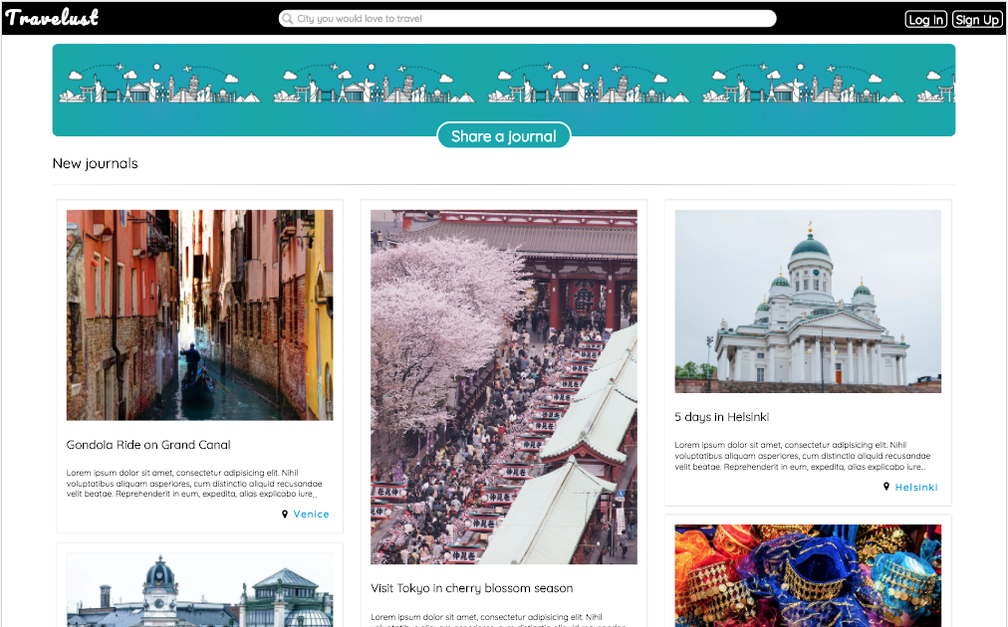
On DeSKTOP

Slide 17
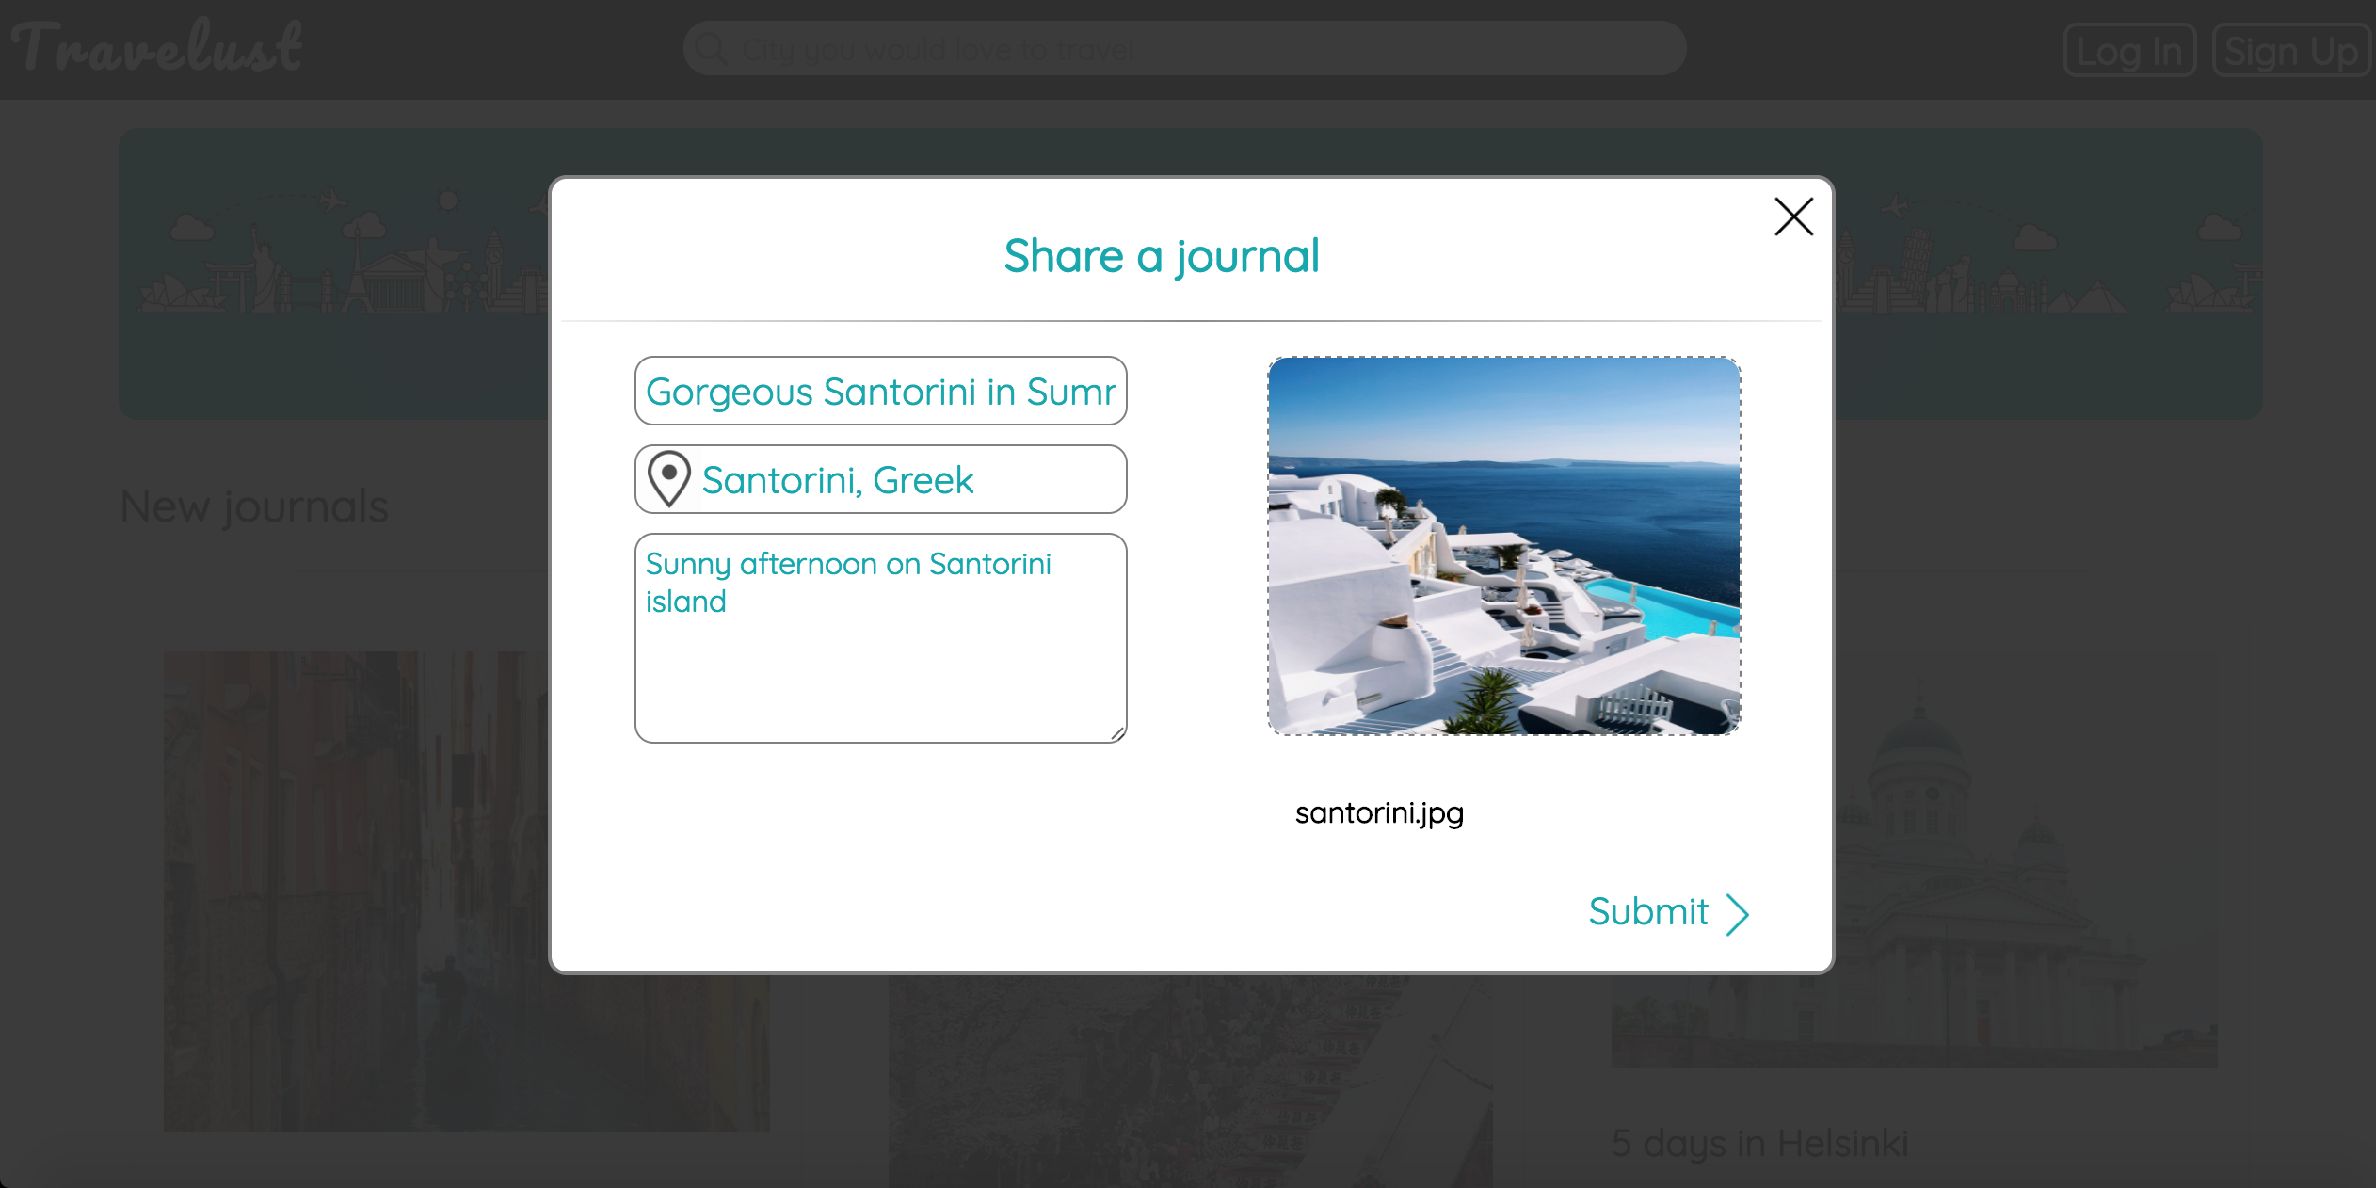
On DeSKTOP

Slide 18
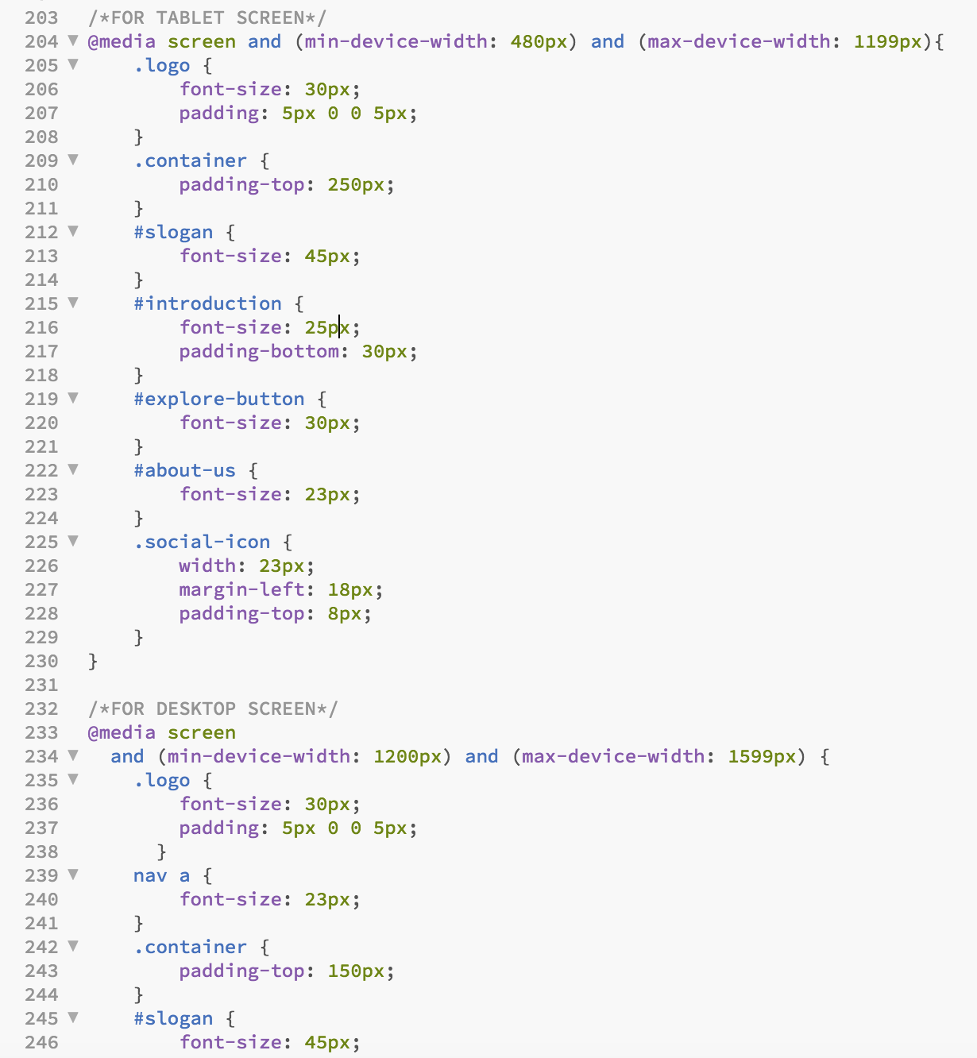
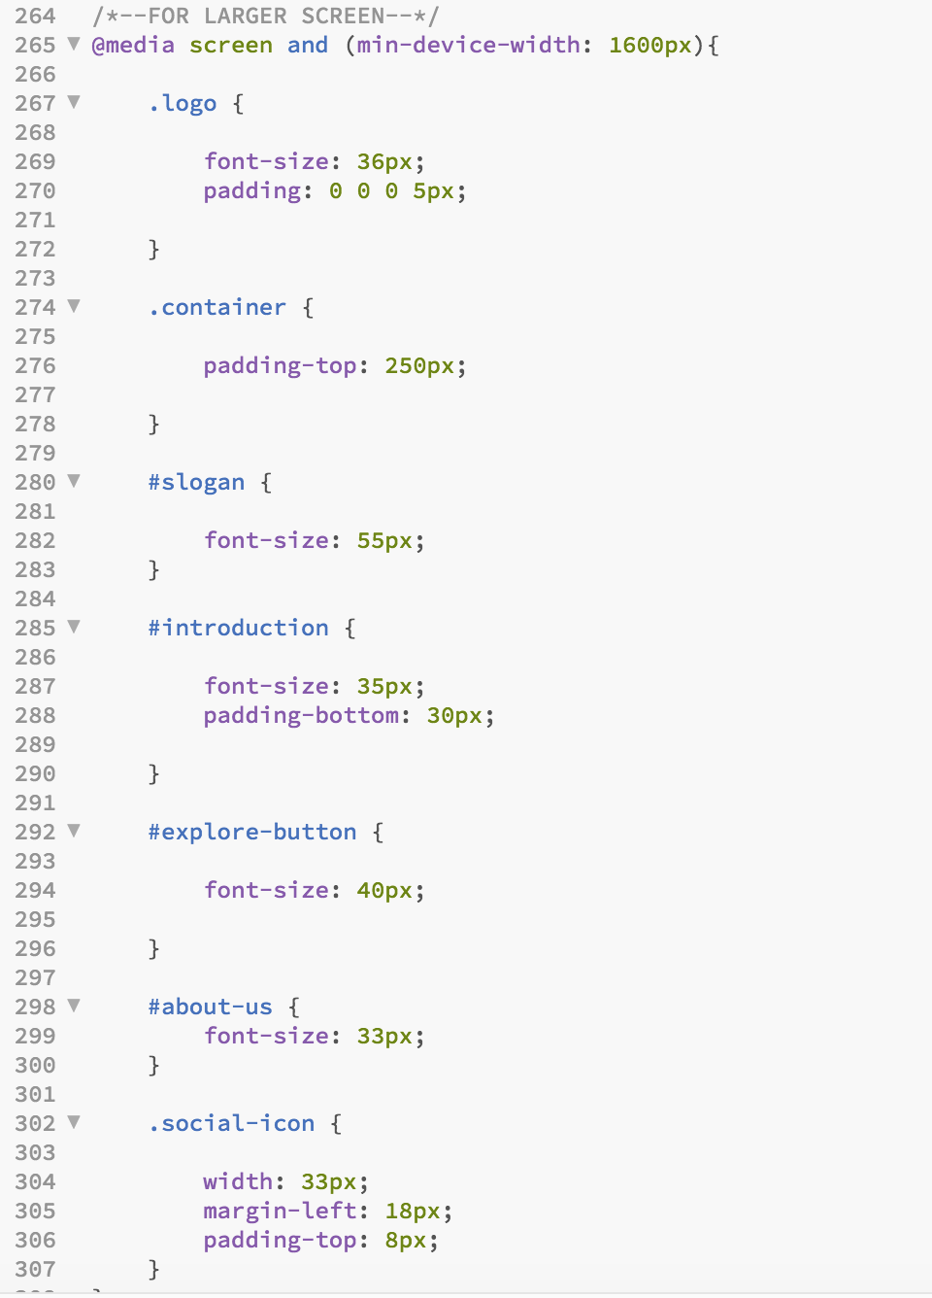
UI/UX Design (Front-end)
Flat design
Mobile-first Responsive

Slide 19
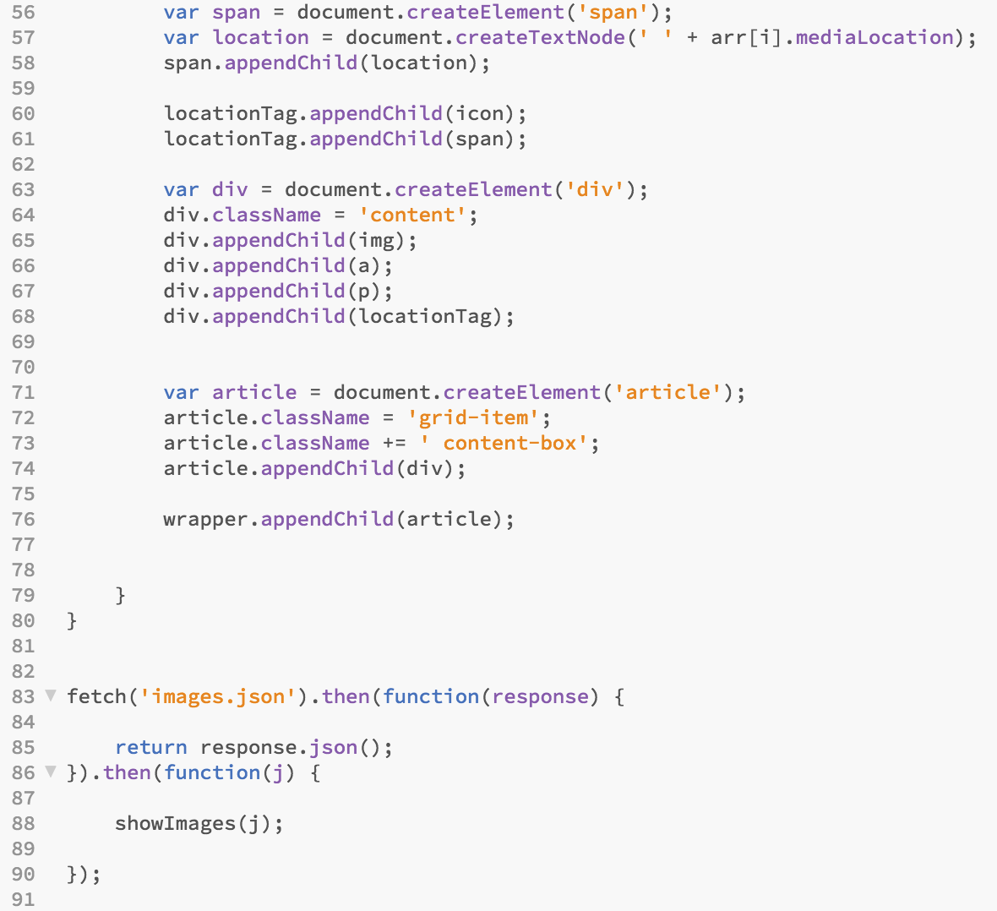
UI/UX Design (Front-end)
Use AJAX and fetch API to create dynamic photo gallery

Slide 20
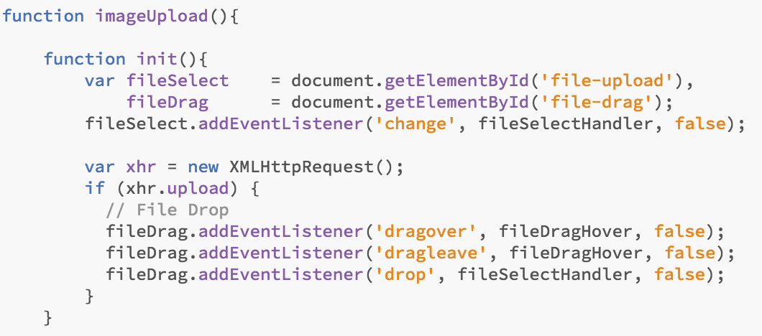
UI/UX Design (Front-end)
Use AJAX and XMLHttpRequest to upload photo to server

Slide 21
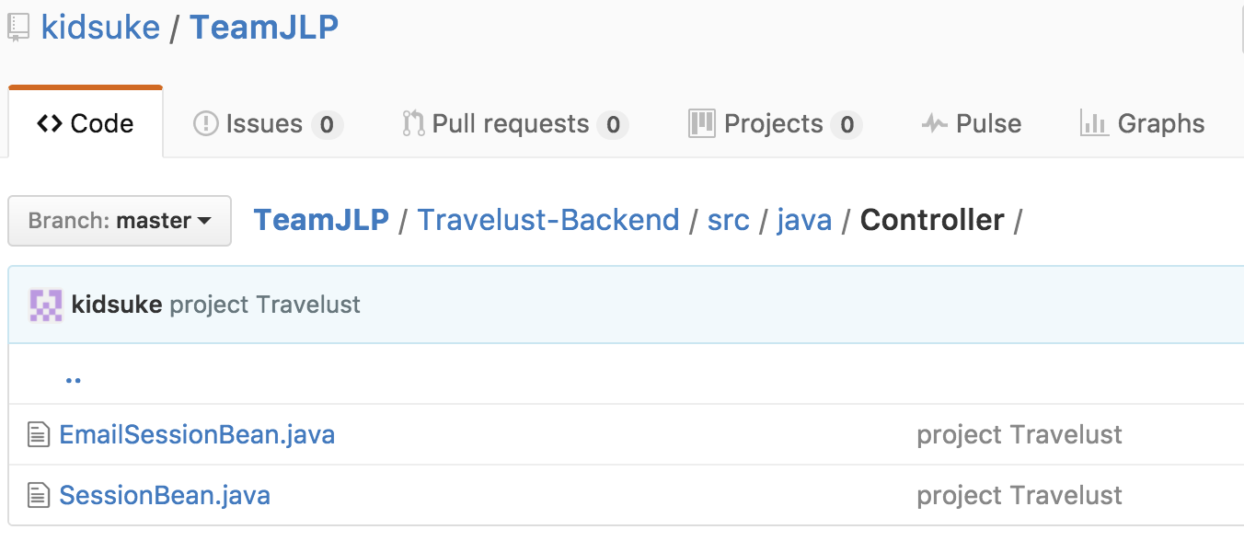
Back-end
EmailSession Bean is used for sending confirm email for user who registered
SessionBean is used for interacting with database

Slide 22
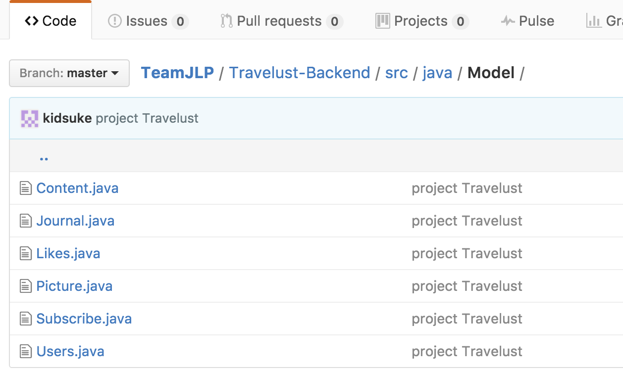
Back-end
EntityBeans which are equivalent to tables in the database

Slide 23
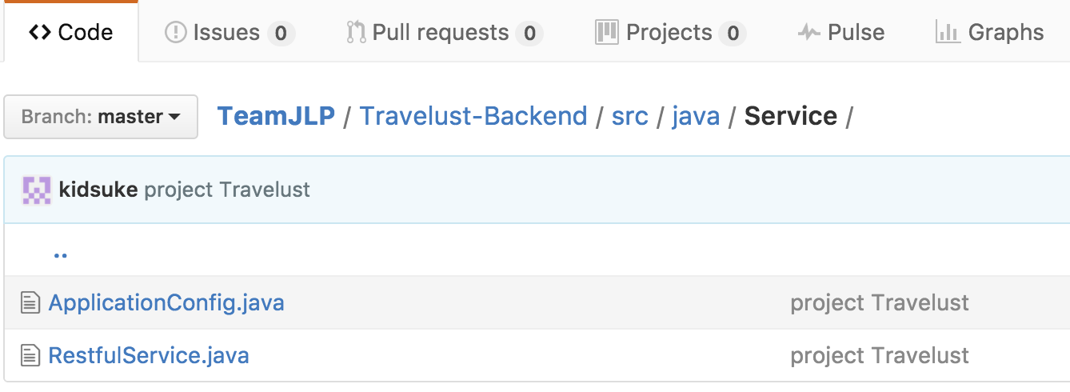
Back-end
With JAX-RS and Jersey, this RestfulService handles request from web tier

Slide 24
Review

Slide 25
Can
Can’t
Responsive Web App with mobile-first principles
2 kinds of users: anonymous and login users
Login user can upload media to the server
Confirm email for registed users
Use cookies to remember login users
Dynamic content using AJAX
Search filter
Statistics: like, comment,…
Upload many photos in the same post
Complete the whole idea

Slide 26
Thanks for listening!

Slide 27
Credits
Special thanks to all the people who made and released these awesome resources for free:
Presentation template by SlidesCarnival

